Slide 1




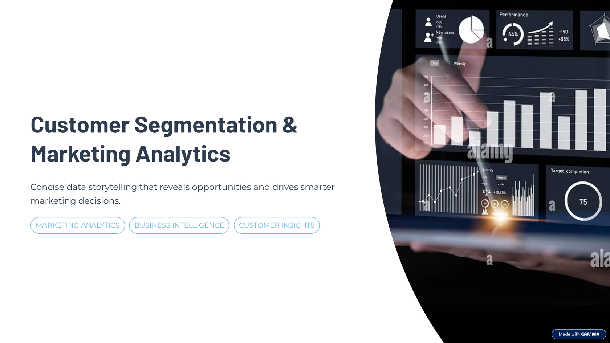

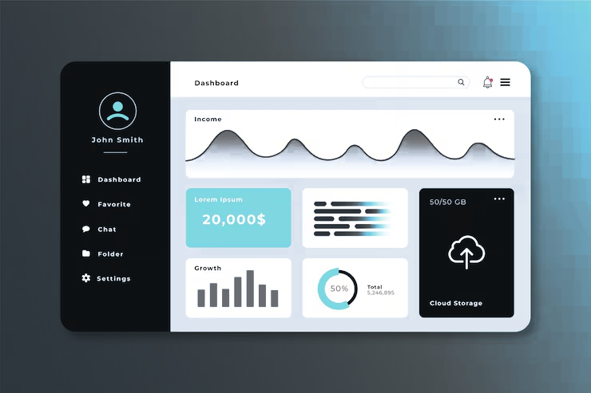



CUSTOMER SEGMENTATION & MARKETING ANALYTICS
Data Storytelling, Dashboarding & Business Insights
By,
C. Chetana

Slide 2


Understanding Customer Behavior at Scale
This project analyzes customer demographics, spending patterns, purchase channels, campaign responses, and satisfaction signals to support data-driven decision-making across marketing and sales teams.
Behavioral Analysis
Campaign Effectiveness
Strategic Segmentation

Slide 3

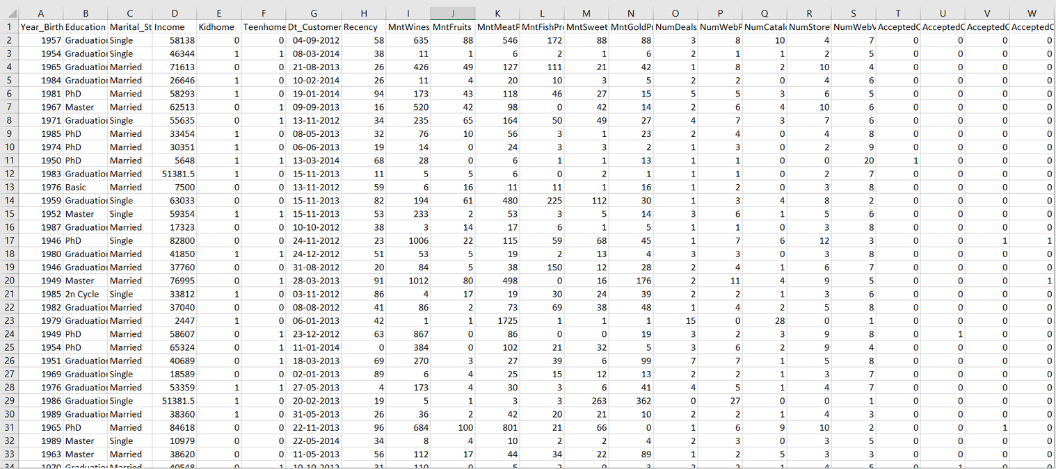
Dataset Overview
The dataset combines demographic, transactional, and behavioral data across five key dimentions.
Demographics
Age, education, marital status, and household composition
Income & Expenses
Annual income and multi-category expenditure data
Responses
Customer service complaint frequency and patterns
Complaints
Acceptance rates across marketing campaigns
Web, catalog, and in-store transaction records
Purchase Channels

Slide 4
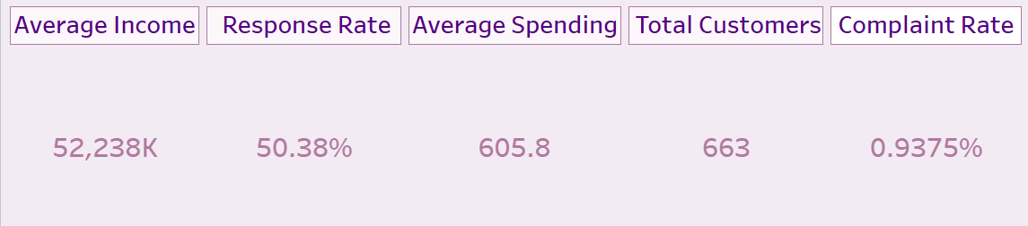

KPI Overview
663 active customers in dataset
52K Annual household income
50% Campaign Acceptance
605.8 Average Spending
0.9% Customers with complaints

Slide 5
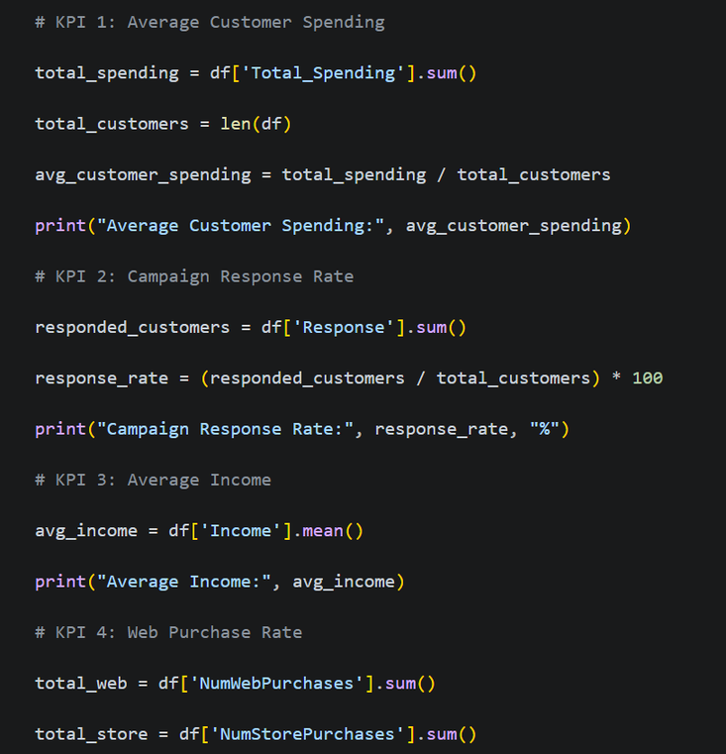

KPI Calculations
Total Customers = COUNT(Customer_ID)
Average Income = AVG(Income)
Average Spending = AVG(Total_Spending)
Response Rate = SUM(Response) / Total Customers *100
Complaint Rate = SUM(Complain) / Total Customers* 100

Slide 6

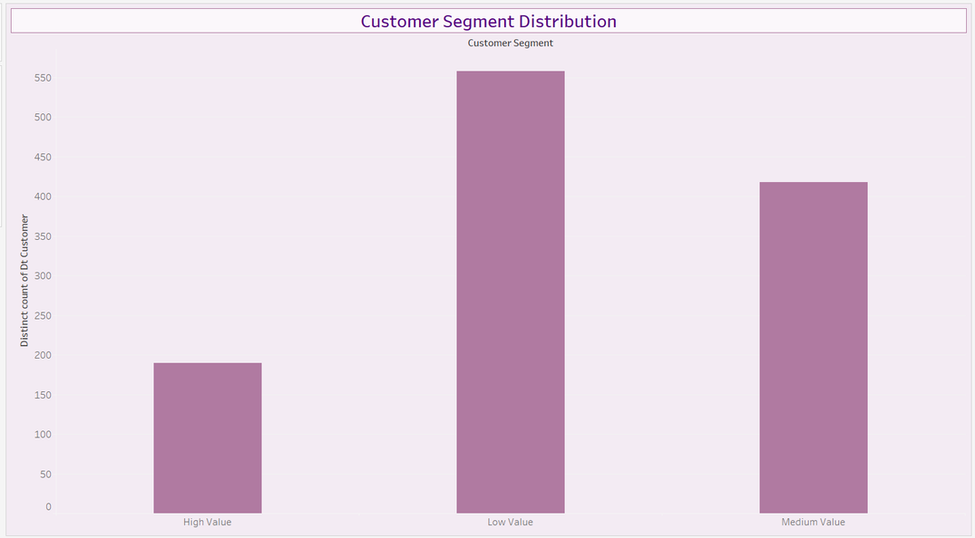
Customer Segment Distribution
Customers were segmented based on spending behavior into High Value, Medium Value, and Low Value groups.
Key Findings:
Low Value customers represent the largest customer segment.
Medium Value customers form the second largest group.
High Value customers represent the smallest segment.
Business Insight:
Although High Value customers are fewer in number, they contribute significantly to revenue generation. Low and Medium Value customers represent opportunities for targeted upselling and retention campaigns.

Slide 7
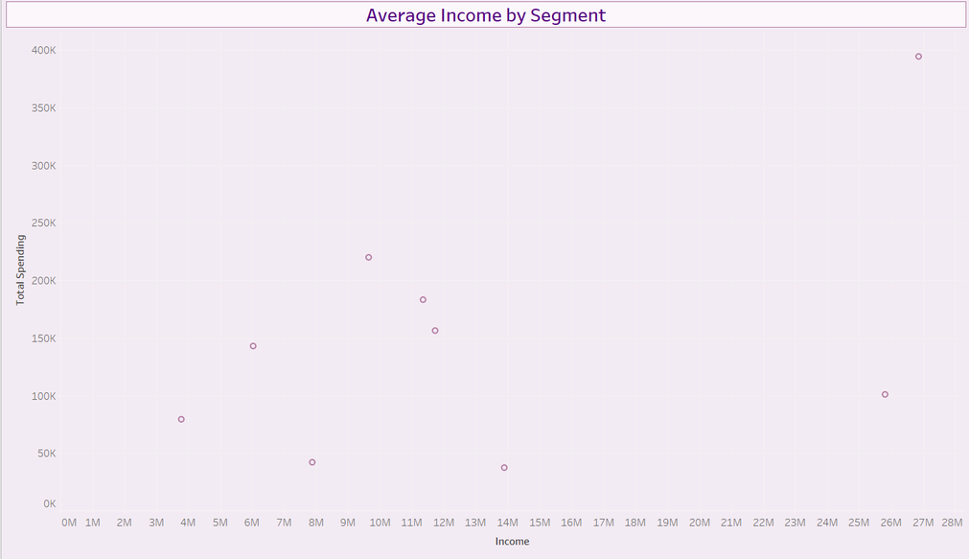
Average Income by Segment
A scatter plot was used to examine how customer income influences total spending.
Key Findings:
Customers with higher incomes generally exhibit higher spending behavior.
A positive relationship exists between income and total spending.
Spending patterns vary across customer groups, indicating diverse purchasing behaviors.
Business Insight:
Income is an important factor influencing customer purchasing power. Businesses can use income-based segmentation to create more effective marketing strategies and personalized offers.

Slide 8
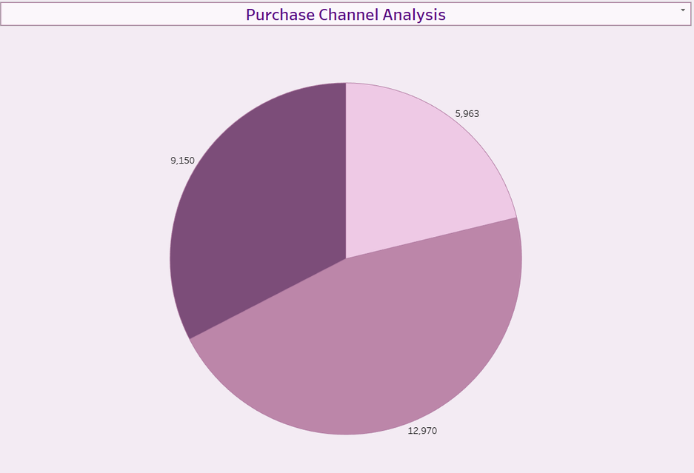
Purchase Channel Analysis
Customer purchasing activity was analyzed across Web, Store, and Catalog channels.
Key Findings:
Store purchases account for the largest share of transactions.
Web purchases contribute significantly to customer activity.
Catalog purchases represent the smallest purchase channel.
Business Insight:
Physical stores remain the dominant sales channel, while web purchases demonstrate strong digital engagement. Continued investment in both channels can help maximize customer reach and revenue.

Slide 9
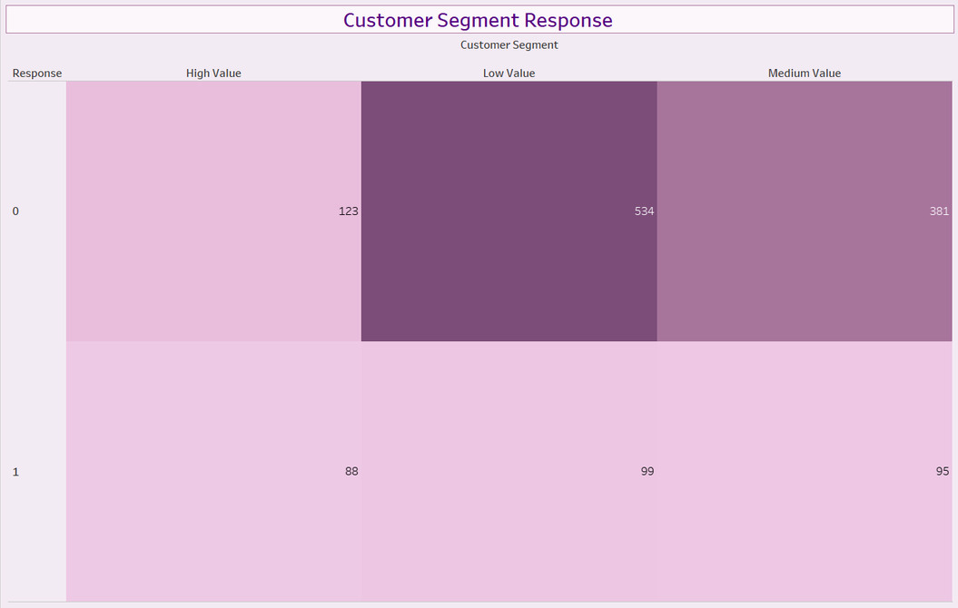
Customer Segment Response
Campaign responses were evaluated across customer segments to understand customer engagement.
Key Findings:
Low Value customers recorded the highest number of non-responses.
Response behavior is relatively balanced across segments.
High Value and Medium Value customers demonstrate meaningful campaign engagement.
Business Insight:
The overall response rate of 50.38% indicates effective campaign performance. Personalized marketing campaigns can further improve conversion rates among low-response customer groups.

Slide 10
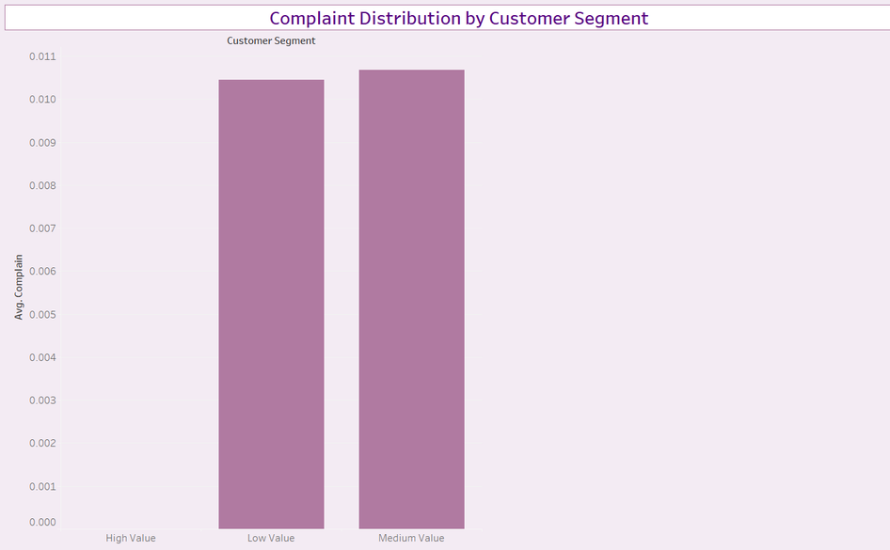
Complaint Distribution by Segment
Complaint rates were analyzed across customer segments to evaluate customer satisfaction.
Key Findings:
Complaint rates remain extremely low across all customer groups.
Medium Value customers show slightly higher complaint levels.
High Value customers reported almost no complaints.
Business Insight:
The overall complaint rate of less than 1% suggests strong customer satisfaction and effective customer relationship management.

Slide 11



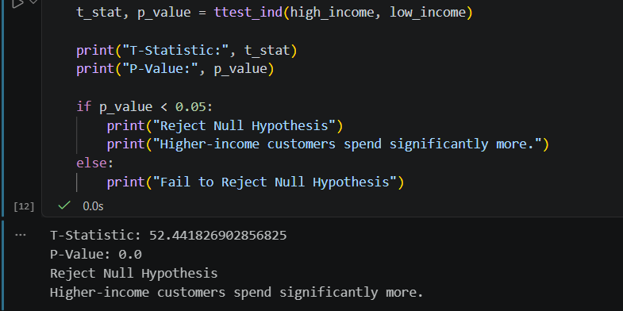
Hypothesis Testing
Null Hypothesis (H₀):
Customer income has no significant effect on total spending.
Alternative Hypothesis (H₁):
Customer income significantly affects total spending.
Results:
Median Income = 51,381.5
T-Statistic = 52.4418
P-Value = 0.0000
Since the p-value is less than 0.05, the null hypothesis was rejected. The analysis confirms that higher-income customers spend significantly more than lower-income customers.

Slide 12

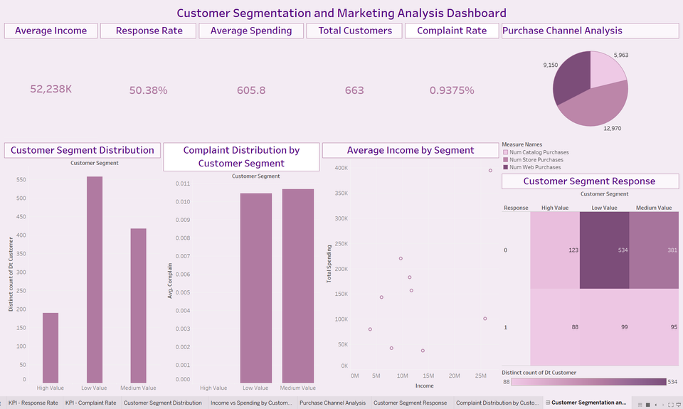
Conclusion
This project leveraged customer segmentation and marketing analytics to uncover key patterns in customer behavior, spending, and engagement.
The analysis showed that income significantly influences spending, while customer segmentation and purchase channel analysis provided valuable insights for targeted marketing strategies.
Overall, the dashboard and statistical validation demonstrate how data-driven decision-making can improve customer engagement, marketing effectiveness, and business growth.
Understanding customer behavior through analytics enables smarter marketing decisions and stronger customer relationships.

Slide 13



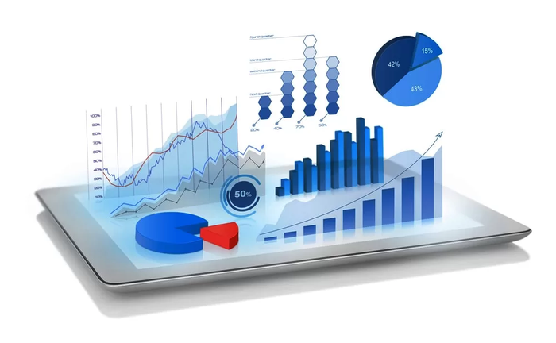
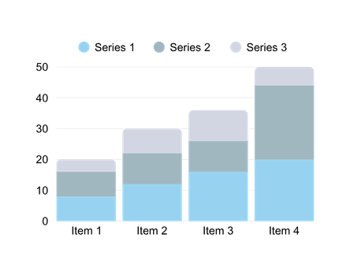
THANK
YOU

